Slide 1
Udyog Saarthi (Progressive Web-based Application)
CSE7101- Capstone Project
Review-3
Batch Number: CSE_20
Under the Supervision of,
Ms. Saiqa Khan - Assistant Professor
Mr. Thatimakula Saikumar – Assistant Professor
School of Computer Science and Engineering
Presidency University
Roll Number | Student Name
20221CSE0307 20221CSE0306 20221CSE0673 | PRIYANKA G PRIYADARSHINI HANSRAJ
Name of the Program: Computer Science and Engineering
Name of the HoD: Dr.Asif Mohammed , Dr.Blessed Prince
Name of the Program Project Coordinator: Dr.Jayavadivel Ravi , Mr.Muthuraju V
Name of the School Project Coordinators: Dr. Sampath A K , Dr. Geetha A

Slide 2
Content
Github link
Abstract
Literature Survey
Objectives
Existing methods & Drawbacks
Proposed method & Feasibility study
Architecture Diagram
Algorithms
Modules
Background and Related work for title Selection
Timeline of the Project
Hardware & Software
References
Future work
Conclusion

Slide 3
Problem Statement Number: PSCS-39
Git-hub Link : https://github.com/Priyankagowda0707/Udyog_Saarthi-PWA
Category : Software
Abstract :
A large number of Persons with Disabilities (PwDs) in India, especially under the D & E categories(Intellectual Disability, Autism Spectrum Disorder, Multiple Disabilities, Mental Illness, Specific Learning Disabilities) of the 4% reservation, remain unemployed due to lack of awareness, inaccessible job information, and limited digital literacy.
Existing portals fail to provide simplified, accessible, and timely updates, resulting in missed opportunities.
There is a need for an inclusive Progressive Web App to bridge this gap with curated job listings, multi-language/audio support, offline access, and real-time notifications.

Slide 4
Literature Survey
Ministry of Statistics and Programme Implementation (MoSPI). (2021). Report on Persons with Disabilities in India:
Link: https://www.mospi.gov.in/sites/default/files/publication_reports/Report_583_Final_0.pdf
Government of India. (2016). The Rights of Persons with Disabilities Act, 2016:
Link:https://www.indiacode.nic.in/bitstream/123456789/15939/1/the_rights_of_persons_with_disabilities_act%2C_2016.pdf
World Health Organization. (2019). Global Report on Disability:
Link: https://www.who.int/teams/noncommunicable-diseases/sensory-functions-disability-and-rehabilitation/global-report-on-health-equity-for-persons-with-disabilities
Dr. D. P. Sharma, (2022). Digital Inclusion of PwDs in India. IEEE Access, 10, 48860-48872: DOI:https://missionspubliques.org/digital-inclusion-bridging-the-divide-with-professor-dr-dp-sharma/?lang=en

Slide 5
Objectives
To develop an accessible PWA that provides curated job information tailored for PwDs, featuring simplified language, text-to-speech, and a screen-reader friendly interface.
To enhance the employability of users by integrating coaching modules, mock tests, and guidance on application processes within the platform.
To increase awareness and utilization of the 4% job reservation policy for PwDs by implementing specific filters and dedicated information sections.
To bridge the communication gap by providing a platform for parents/guardians to track opportunities and their ward's progress, addressing literacy barriers.
To ensure wide accessibility by deploying a low-data usage PWA compatible with various devices (desktops, smartphones, tablets), especially in semi-urban and rural areas.

Slide 6
Existing methods & Drawbacks
Many PwDs under D & E categories are unaware of job opportunities due to inaccessible formats and lack of simplified communication.
Existing portals are complex and not designed for users with intellectual or learning disabilities.
Information is often available only in English or complicated technical language, making it harder to understand.
No central platform exists to combine job listings, training resources, and notifications for PwDs.
Lack of offline access means people in rural or low-internet areas miss updates.
Without timely alerts, many deadlines are missed, reducing chances of employment.

Slide 7
Proposed method & Feasibility study
Proposed Method:
The proposed solution is the "Udyog Saarthi" Progressive Web App. Its innovation lies in its integrated, accessible, and user-centric design:
PWA Architecture: Ensures cross-device compatibility, offline functionality, and low data usage—critical for users in areas with poor connectivity.
Integrated Features: Combines job listings (with reservation filters), training modules, mock interviews, and a dedicated guardian portal in one platform.
Multilingual TTS Support: Breaks language and literacy barriers by reading content aloud in multiple languages.
Feasibility Study
Technical Feasibility: The chosen tech stack (React.js, Node.js, MongoDB) is mature, well-documented, and has strong community support. PWA technology is stable and proven. Required APIs (TTS) are readily available.
Economic Feasibility: The project uses open-source technologies, minimizing software costs. Deployment on cloud platforms like AWS/GCP offers a pay-as-you-go model, keeping operational costs low and scalable. This aligns with the non-profit, social welfare goals of the partnering ministry.

Slide 8
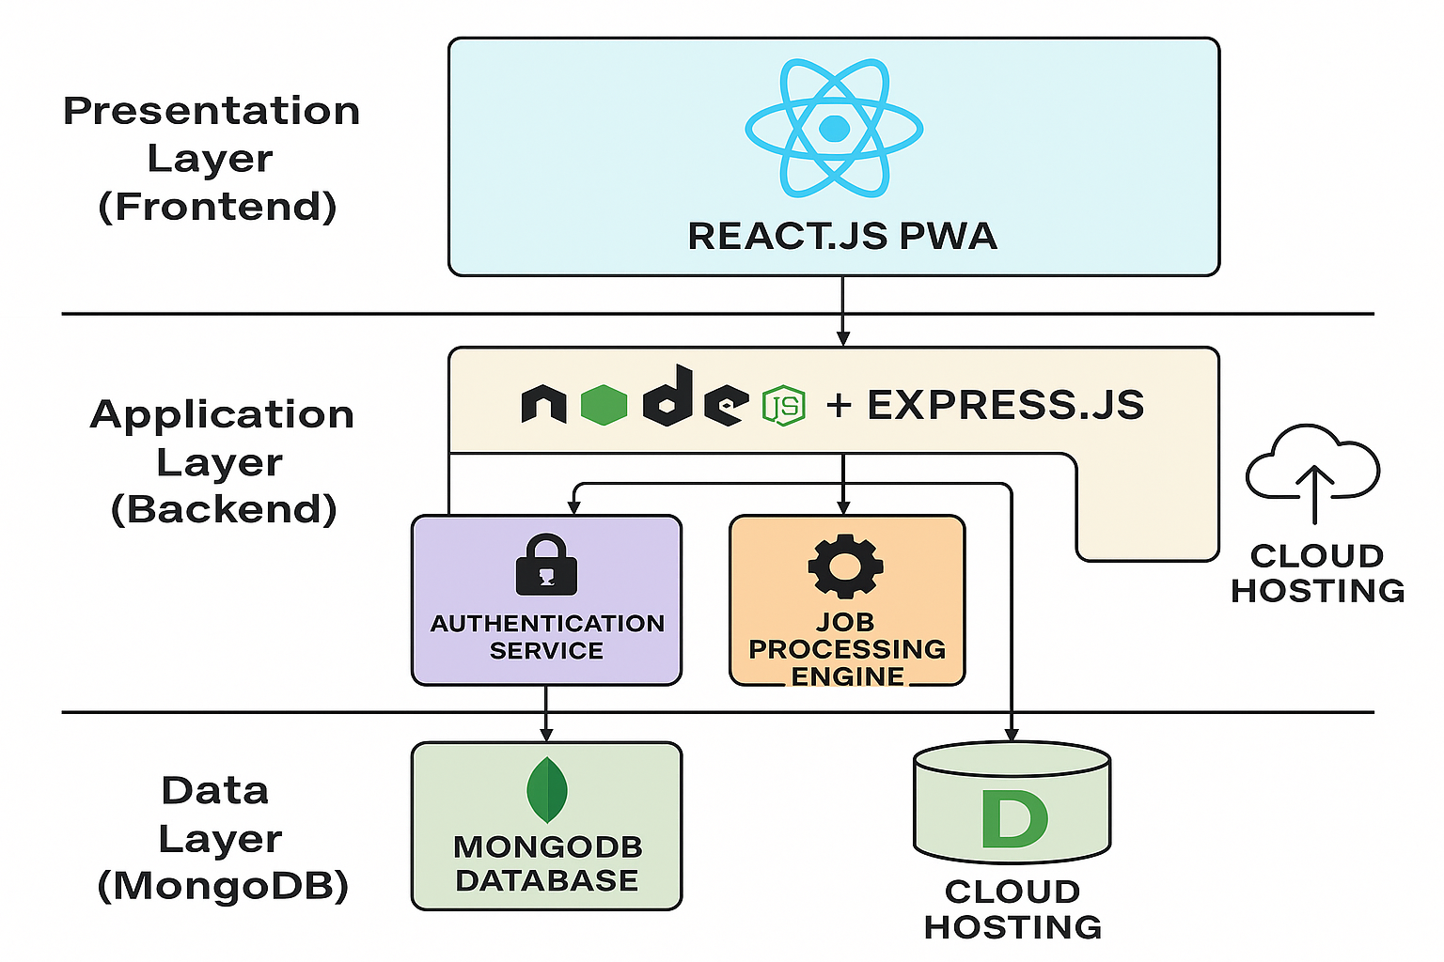
Architecture Diagram

Slide 9
Architecture Diagram continue…….
The system architecture follows a modern 3-Tier Web Application model:
Presentation Layer (Frontend): A React.js Progressive Web App (PWA) that runs on the user's browser/device. It is responsible for the accessible user interface, rendering job listings, training content, and interacting with the backend via RESTful APIs.
Application Layer (Backend): A Node.js + Express.js server. It handles all business logic: user authentication (via JWT), processing job search requests, managing training modules, and serving content to the frontend. It acts as an intermediary between the frontend and the database.
Data Layer: A MongoDB database stores all persistent data, including user profiles, job listings, training materials, and application tracking data.
Key Components:
Authentication Service: Manages user logins (PwDs, Guardians, Admin) using JWT.
Job Processing Engine: Fetches, filters, and categorizes job data from sources.
TTS Service: Integrates with a Text-to-Speech API to convert text content to audio.
Cloud Hosting: The entire application is deployed on a cloud provider (AWS/GCP) for reliability and scalability.

Slide 10
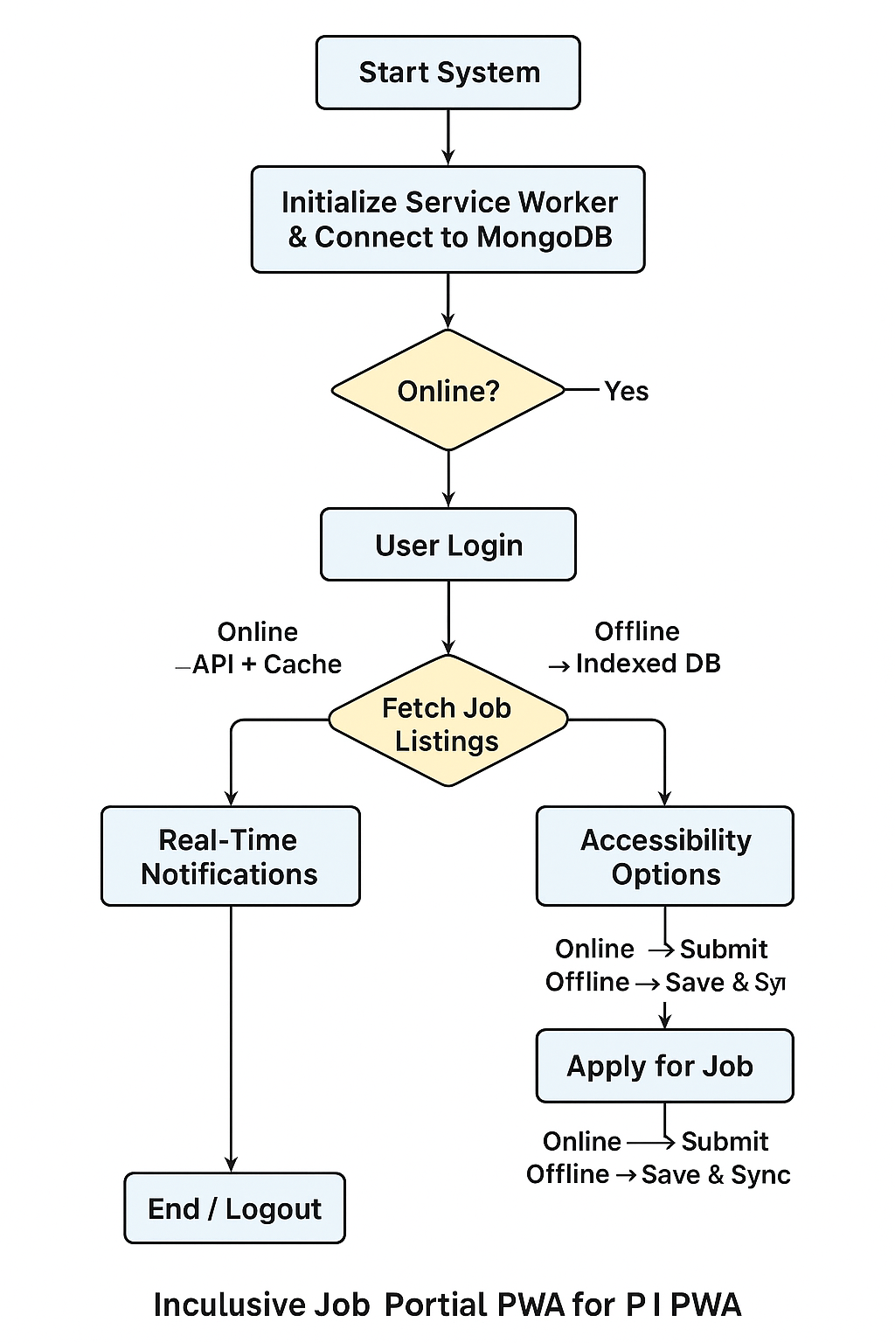
Algorithm

Slide 11
Modules
User Authentication Module: Handles secure registration and login for PwDs and Guardians using JWT.
Profile Management Module: Allows users to create and manage their profiles, specifying disability type, skills, and job preferences.
Job Search & Listing Module: The core module to browse, search, and filter job opportunities specifically based on reservation categories and disability type.
Training & Coaching Module: Provides access to skill development videos, mock tests, and application guidance resources.
Accessibility Module: Integrates TTS functionality, language selection, and ensures UI compliance with accessibility standards.
Notification Module: Alerts users and guardians about new job postings, application deadlines, and new training content.
Admin Portal Module: Allows the admin to post new jobs, manage training content, and oversee user accounts.

Slide 12
Background and Related work for title Selection
Background
In India, 64% of Persons with Disabilities (PwDs) are unemployed.
The government has a 4% job reservation for PwDs, but many still miss out.
Main reasons: lack of awareness, hard-to-read job information, low digital skills, and late updates.
Current job platforms are not fully accessible for PwDs, especially in D & E categories.
Related Work
Employment News Online – Shares jobs but no audio or simple language support.
National Career Service (NCS) Portal – Has job listings but not PwD-friendly.
NGO Training Apps – Teach skills but do not connect directly to government job updates.
Key Need
A single, easy-to-use platform with job info, training details, real-time alerts, and offline access for PwDs.

Slide 13
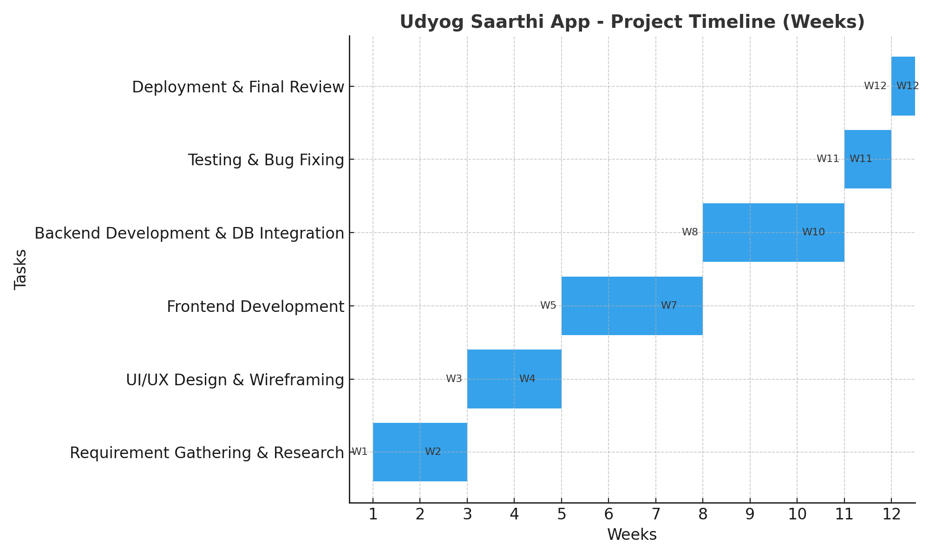
Timeline

Slide 14
Hardware & Software
Category | Details
Frontend | React.js (PWA), HTML5, CSS3, JavaScript (ES6+)
Backend | Node.js, Express.js
Database | MongoDB
Authentication | JWT (JSON Web Tokens)
Version Control | Git, GitHub
Development Tools | VS Code, Postman
Hosting Platform | AWS EC2 / S3 or Google Cloud Platform (GCP)
End-User Hardware | Smartphones, Tablets, Desktops/Laptops with a modern browser (Chrome, Edge, Firefox) and internet connection.

Slide 15
References
Ministry of Statistics and Programme Implementation. (2021). Report on Persons with Disabilities in India.
Government of India. (2016). The Rights of Persons with Disabilities Act.
World Health Organization. (2019). Global Report on Disability.
Dr. D. P. Sharma, "Digital Inclusion of PwDs in India," in IEEE Access, vol. 10, 2022.
S. Gupta, "Inclusive Employment Platforms for Persons with Disabilities," Springer,021.
Darcy, S., & Taylor, T. (2009). Disability citizenship and digital capital: The case of web accessibility.
Lazar, J., et al. (2015). What Frustrates Screen Reader Users on the Web: A Study of 100 Blind Users.
Bühler, C., & Heck, H. (2001). Empowerment by Digital Media of People with Disabilities.
Kumar, A., & Singh, P. (2020). A Study on Challenges Faced by Persons with Disabilities in India in Accessing Employment.
W3C Web Accessibility Initiative (WAI). Web Content Accessibility Guidelines (WCAG) 2.1.

Slide 16
Future Work
Add smart job suggestions using AI, so users see jobs that fit their skills.
Improve accessibility features like sign-language support, voice commands, and simple navigation.
Allow offline job applications, which will automatically submit when the internet is back.
Work with government portals and NGOs to bring in more job opportunities.
Create a dashboard with insights to help policymakers and NGOs understand user needs better.
Build mobile apps for Android and iOS for easier access

Slide 17
Conclusion
This project introduces an inclusive job portal PWA for Persons with Disabilities (PwDs) that solves problems of inaccessible job information, lack of awareness, and low digital literacy. Using the MERN stack, it provides offline access, real-time notifications, multilingual support, and text-to-speech to make job opportunities more accessible. The system ensures usability even without internet and delivers timely updates from government job sources. In the future, features like AI-based job suggestions, better accessibility tools, offline job applications, and mobile apps can make the platform even stronger. Overall, it is a practical and impactful solution to bridge the employment gap for PwDs.

Slide 18


